Slide 1
Introduction to Enterprise Bus (EB)
Madhu Venkat
Guest Faculty
BITS, WILP

Slide 2
In this segment
Introduction to ESB
ESB – Overview
Capabilities of an ESB
Why ESB is important?
ESB challenges

Slide 3
Defining the ESB
"A style of integration architecture that allows communication via a common communication bus that consists of a variety of point-to-point connections between providers and users of services."
"An infrastructure that a company uses for integrating services in the application landscape."

Slide 4
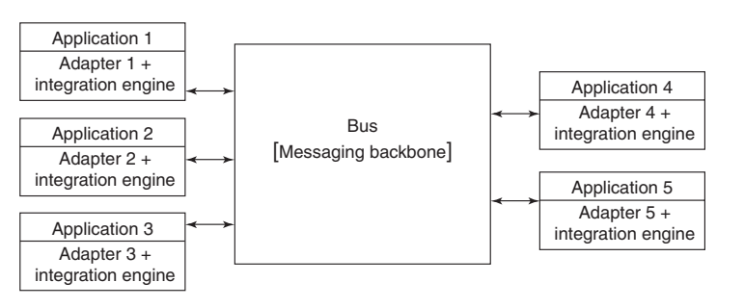
What is an ESB?
A bus based architecture to enable integration of multiple heterogenous systems in an efficient manner.
A sophistication over traditional P2P integrations
ESB acts as an intelligent middleware to enable communication among different systems/application.

Slide 5
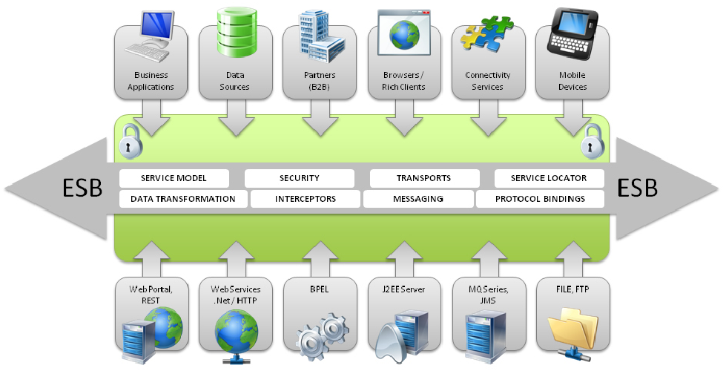
ESB Architecture

Slide 6
Capabilities of ESB
Routing – Logically route data to different integrated servers/applications.
Orchestration – Combining functionalities of discrete services to provide aggregated services.
Transformation/Translation – Data formats transformations and translations as per connected application needs. Example (SOAP to Rest , JSON to XML conversions)
Mediation/Message Enrichment – Customize, enrich, re-format messages as a middleware/mediator.
Transportation/Protocol conversions – Transportation of data between connected systems as per supported transport protocols.
Non-Functional Consistency – Enforcement of security policies, monitoring, management , HA/FT

Slide 7
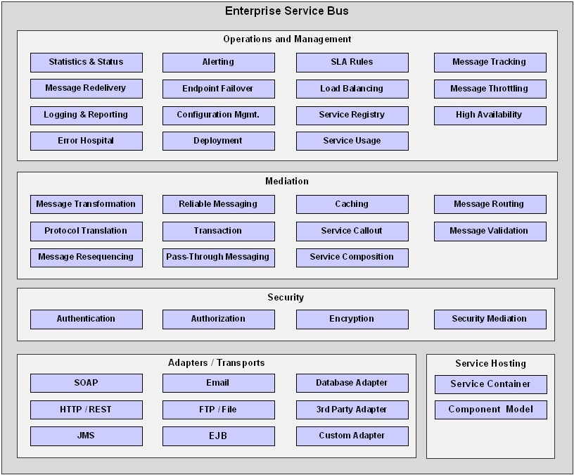
ESB Blueprint

Slide 8
When Should an ESB be used?
The use of an ESB is worth considering when three or more applications or services need to be integrated.
A simple point-to-point integration is significantly easier and much more cost-effective when connecting two applications.
An ESB can also be worthwhile if services are going to be incorporated from external service providers over which the company has no control.
The ESB can then be used to monitor the service level agreements that the external provider guarantees.
If many different protocols, such as HTTP, SOAP, and FTP, are to be used and standardized to one protocol like SOAP, the ESB can perform the necessary protocol transformation.
If services are to be consistently incorporated into an architecture to be able to receive, process, and produce messages, then the use of ESB is also suitable.

Slide 9
Why ESB is important?
Efficient decoupling of multiple systems/applications.
Better use of integration capabilities.
Improved time to market and conditions.
Better synchronization for upgrades, monitoring and management of integration layer

Slide 10
Challenges with ESB
ESB itself can become a bottleneck and a single point of failure.
ESBs have associated regression of risks with dozens of heterogenous systems/applications connected.
Changes/upgrades to a single fat middleware may have ripple effect on many functionalities.
ESB products have a learning curve involved and lack of professionals in the market.

Slide 11
ESB tools
IBM Websphere
Microsoft BiZtalk
Oracle ESB
Mule ESB
RedHat JBOSS Fuse

